Slide 1
Logimic Light
Smart Open-Air Lighting
Michal Valný

Slide 2
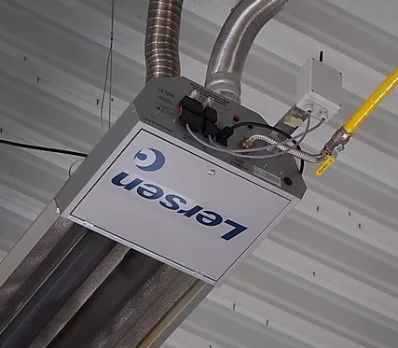
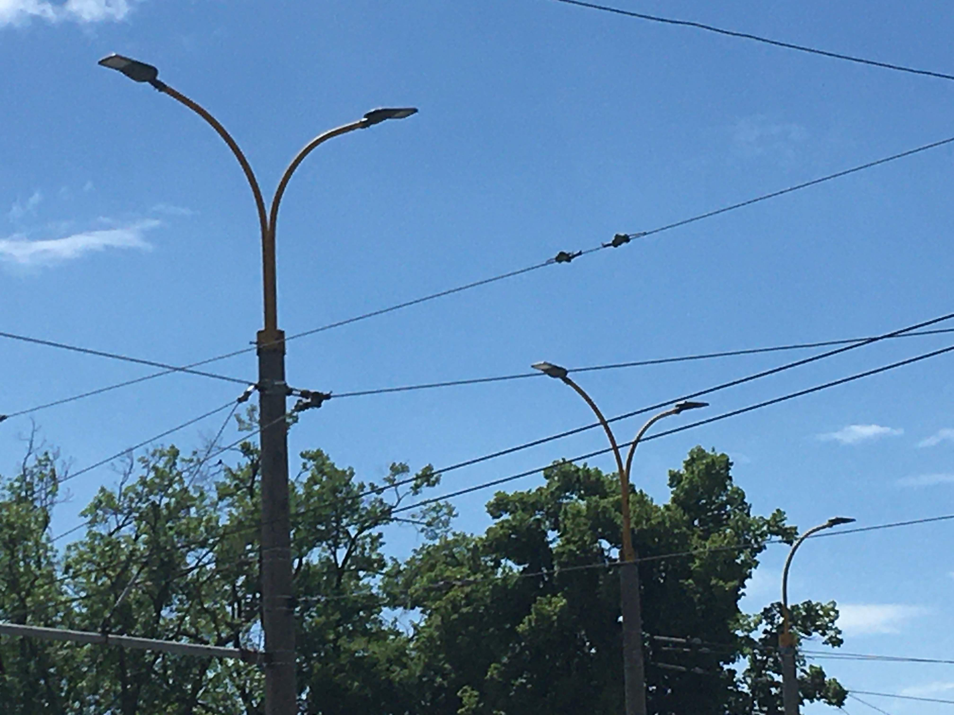
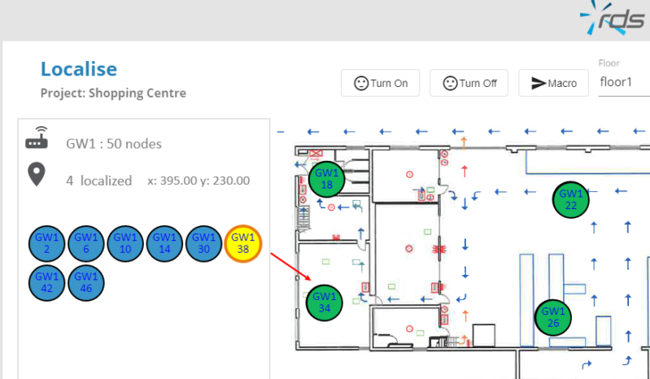
About Logimic
michal.valny@logimic.com
Gateways Software
Industrial heating
Open-air lighting
Software Services

Slide 3
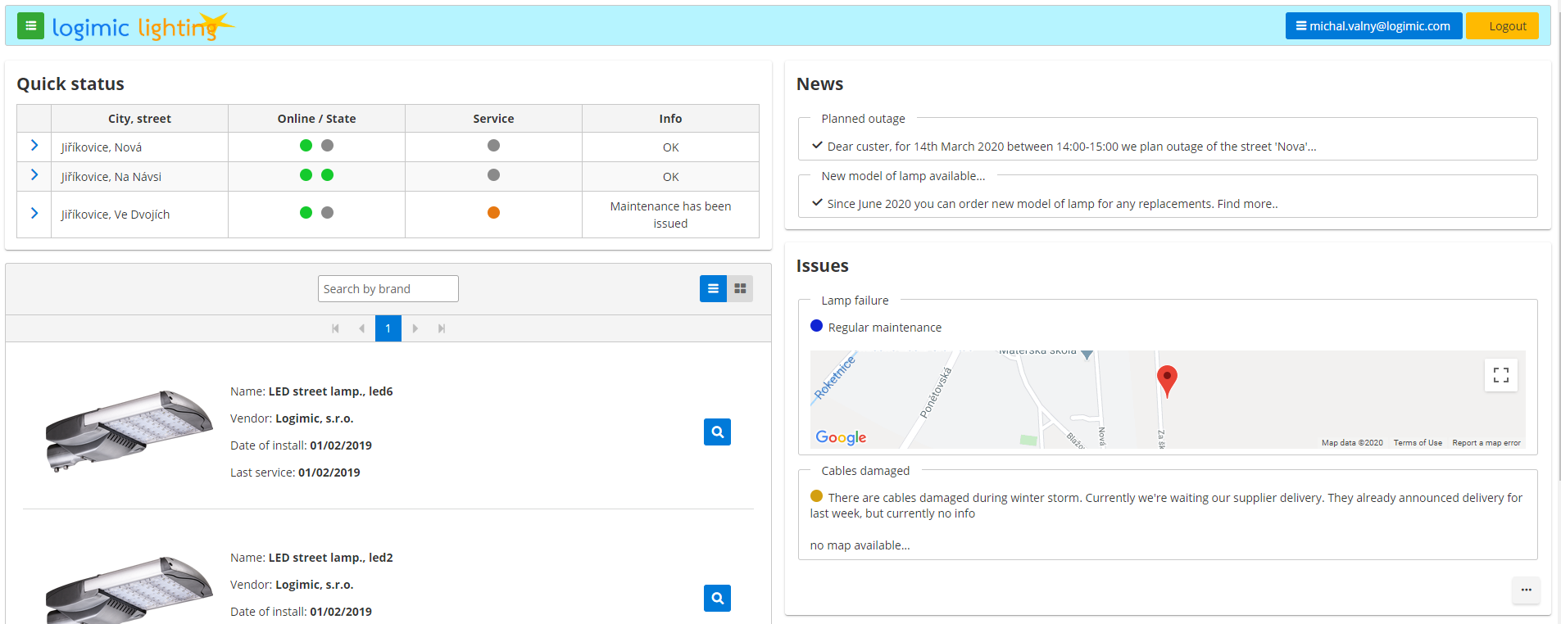
Logimic Light
michal.valny@logimic.com www.logimiclight.com
- Open-air lighting platform for cities and villages
- Focus on simple and low-cost IOT solution

Slide 4
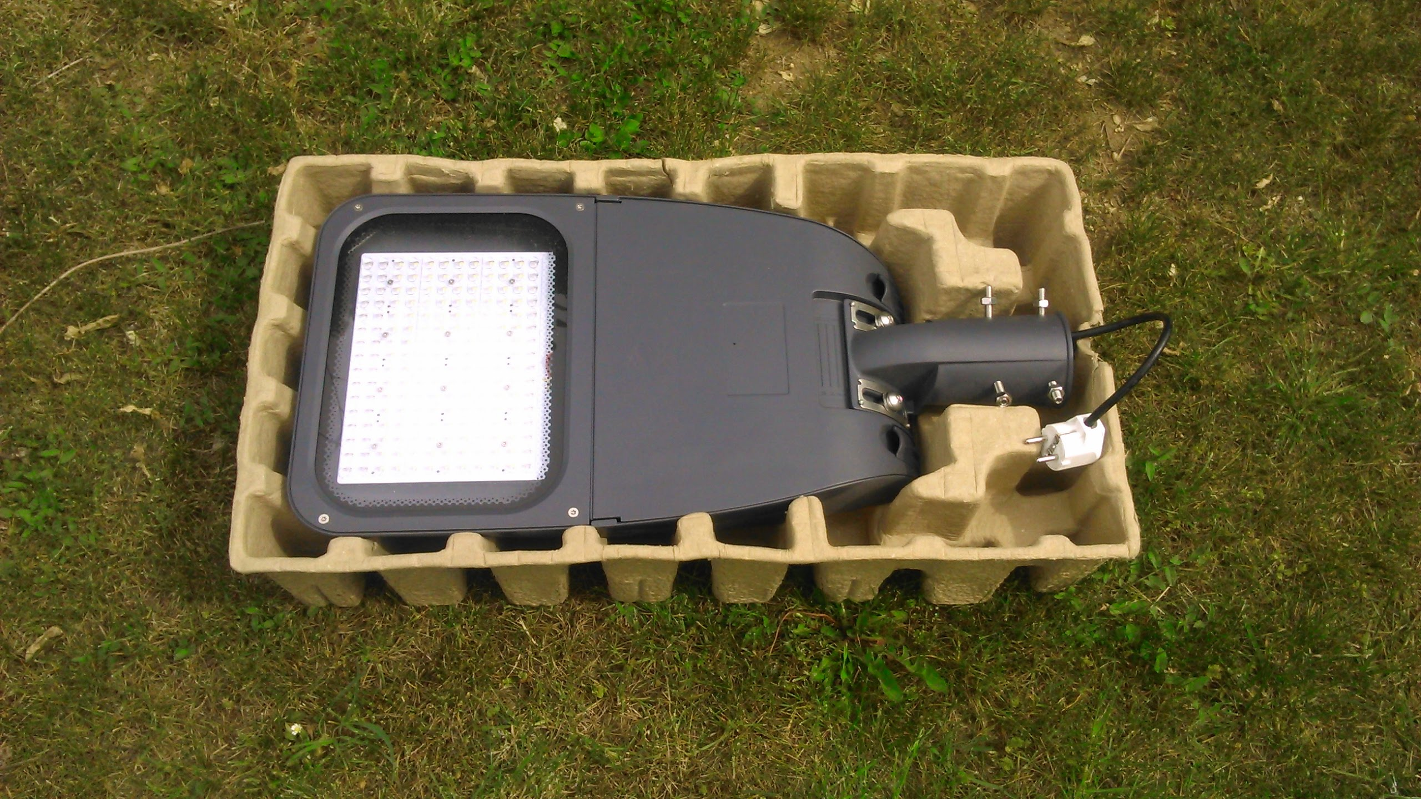
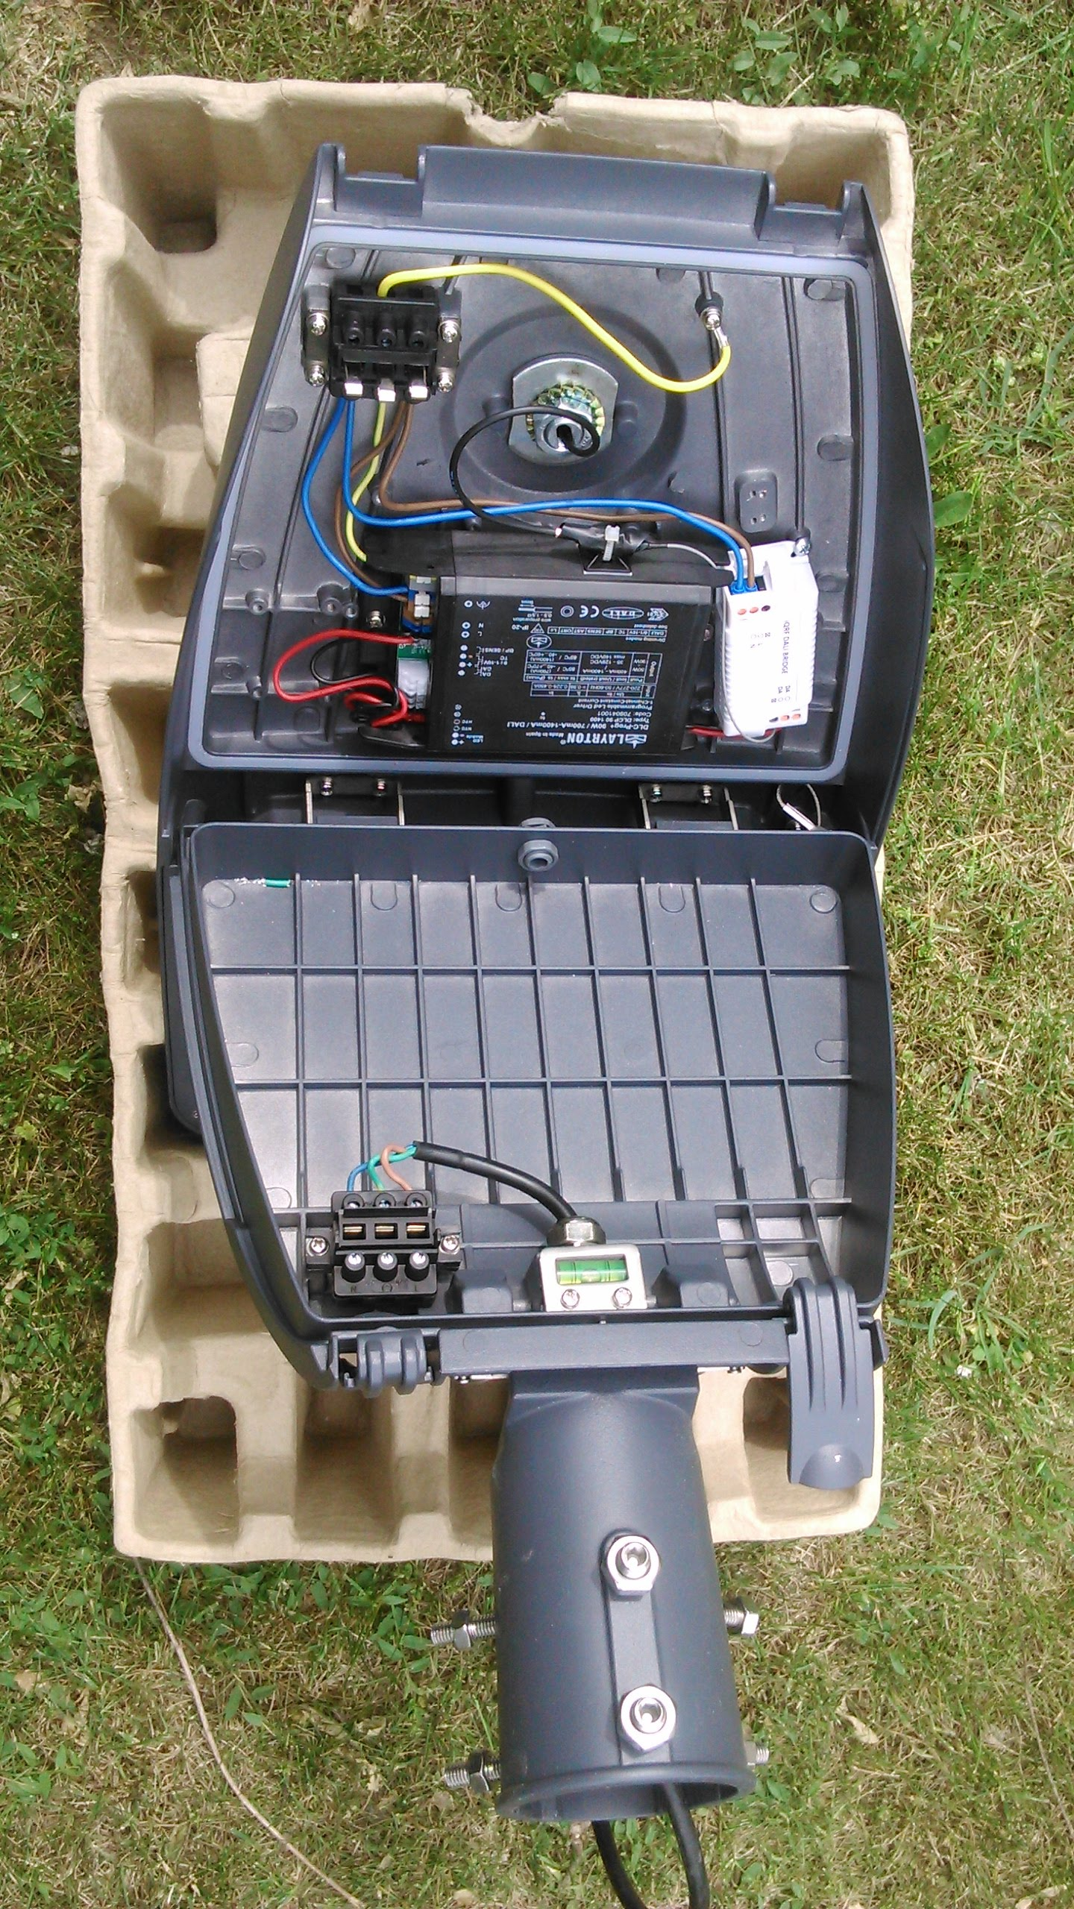
Lamp Hardware
michal.valny@logimic.com www.logimiclight.com
- IQRF DALI bridge
- QEL-PRO LED lamp

Slide 5
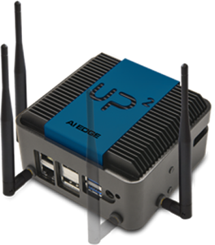
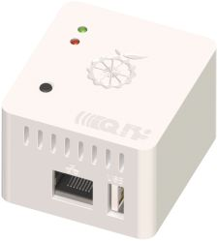
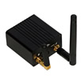
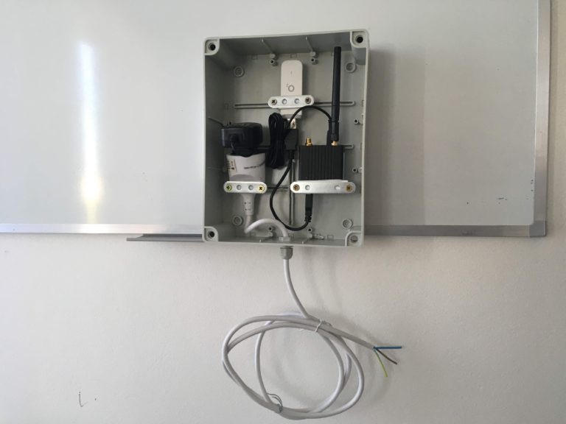
Gateway Hardware
michal.valny@logimic.com www.logimiclight.com
variable gateway hardware
- Gateway
- IP 65 Outdoor Box
- 4G LTE modem
- Power Adapter

Slide 6
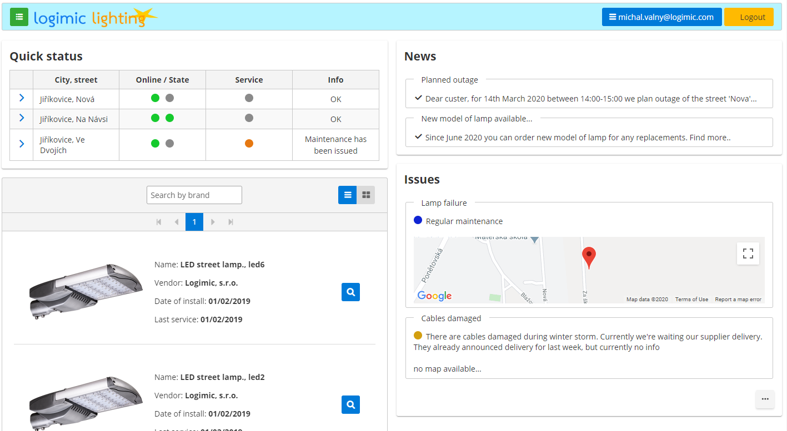
Logimic Light
User, Syste
michal.valny@logimic.com www.logimiclight.com
News
Quick Status of Locations
Issues, failures
My devices

Slide 7
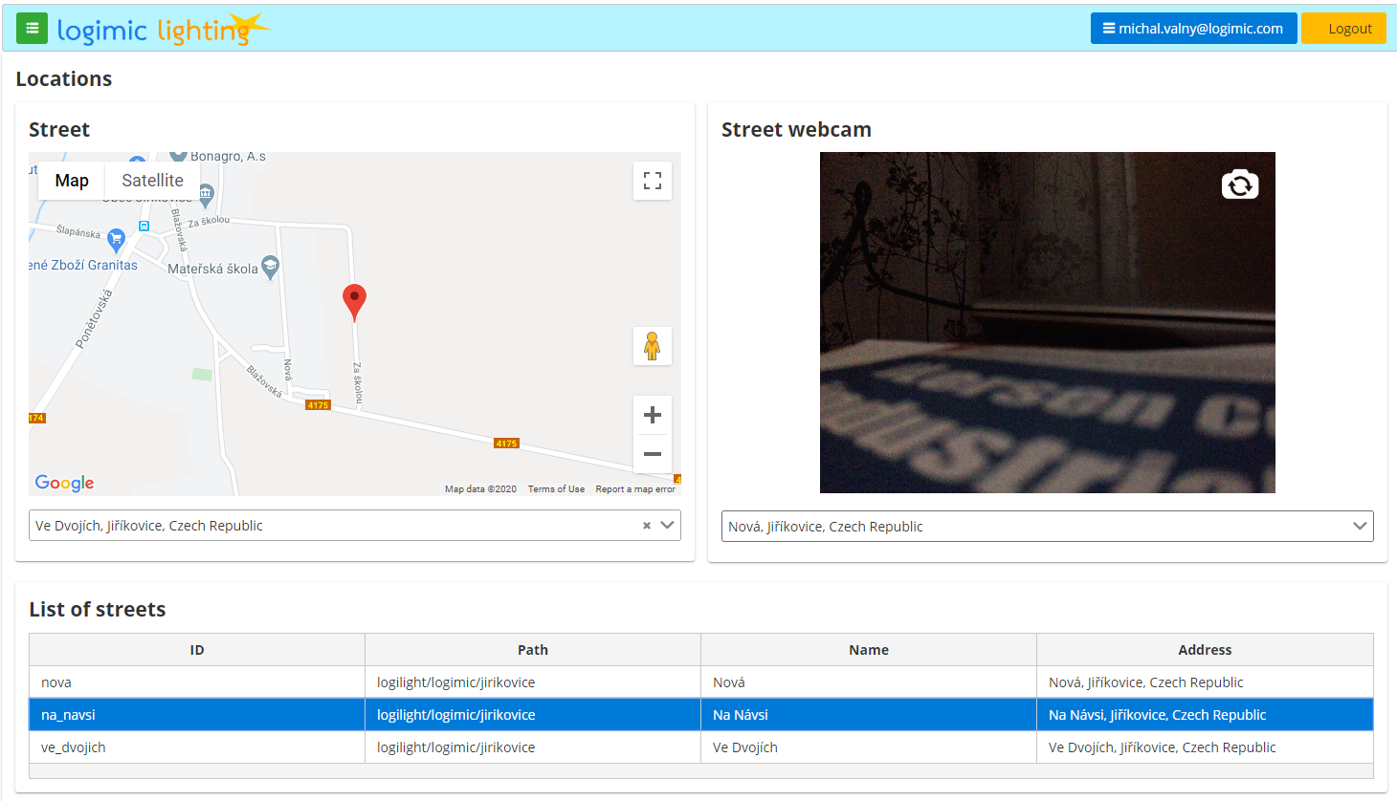
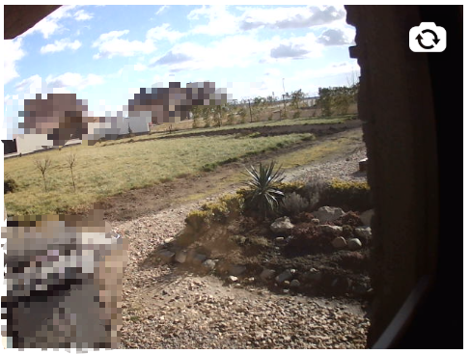
Logimic Light
michal.valny@logimic.com www.logimiclight.com
Web cam optionally
Street city map
Locations

Slide 8
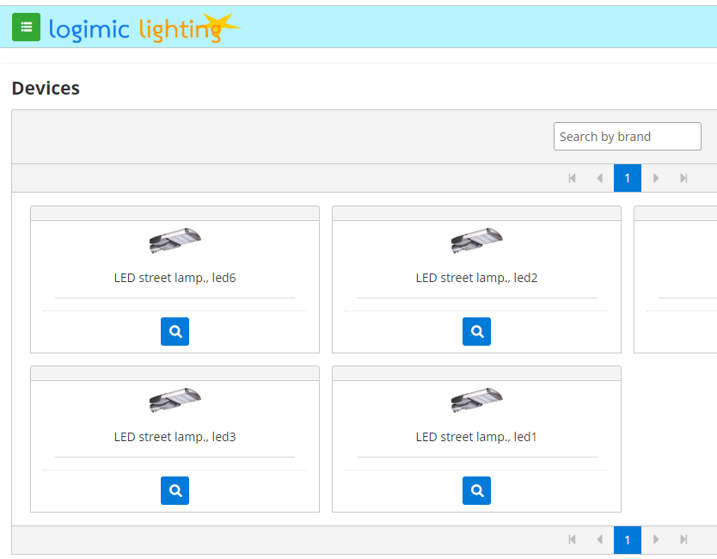
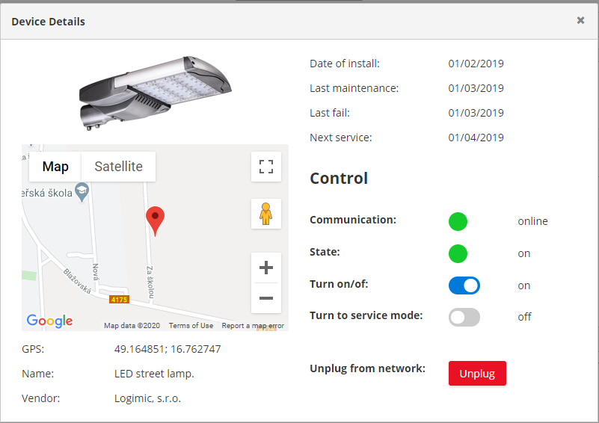
Logimic Light
michal.valny@logimic.com www.logimiclight.com
Device Details
Manual Control
Devices cards
GPS
Notifications
Maintenance tasks

Slide 9
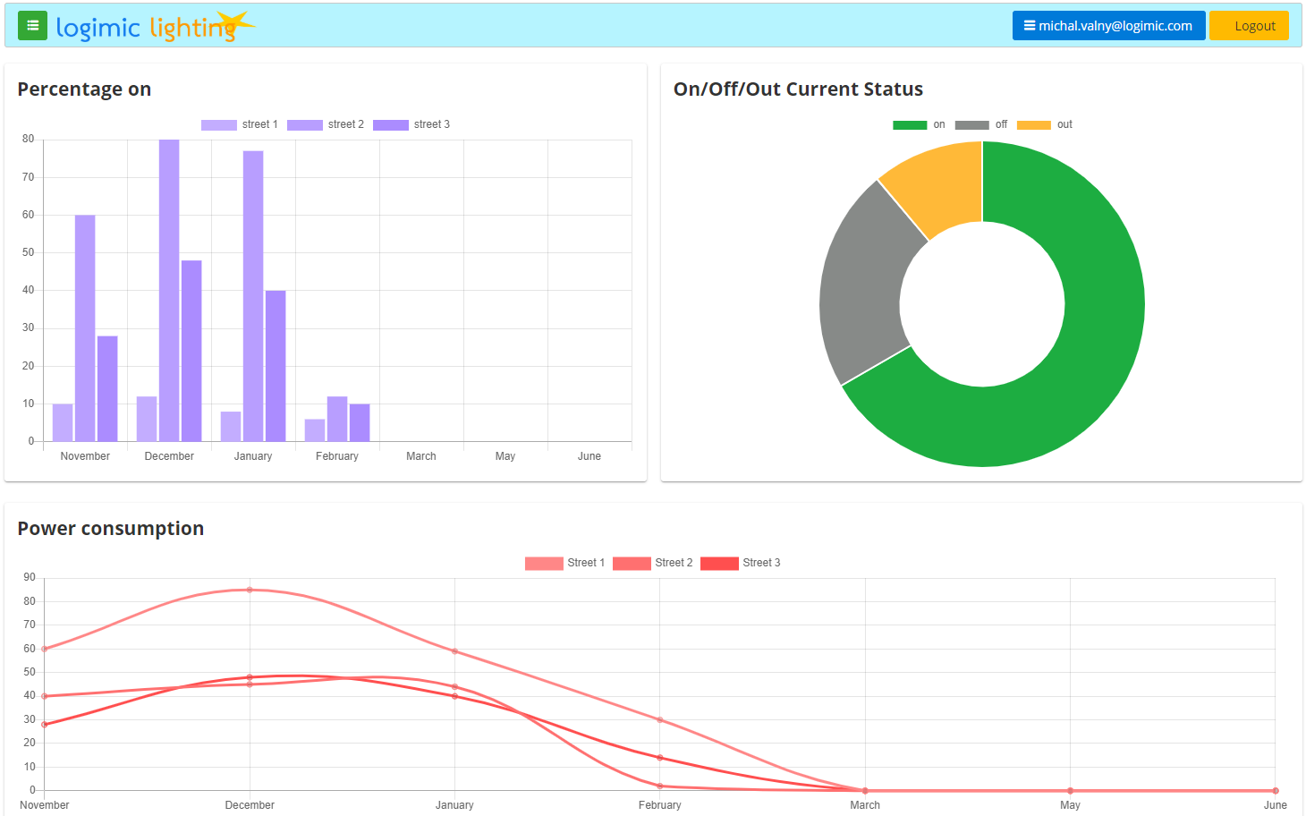
Logimic Lighting
Statistics
michal.valny@logimic.com www.logimiclight.com
Current status
Power on time
Consumption

Slide 10
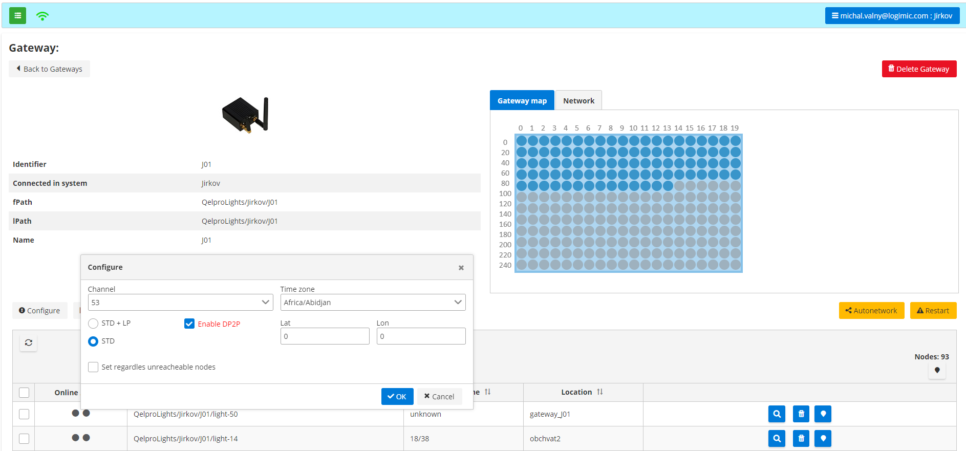
Logimic Lighting
michal.valny@logimic.com www.logimiclight.com
Gateway Nodes
Autonetwork
DP2P enable

Slide 11
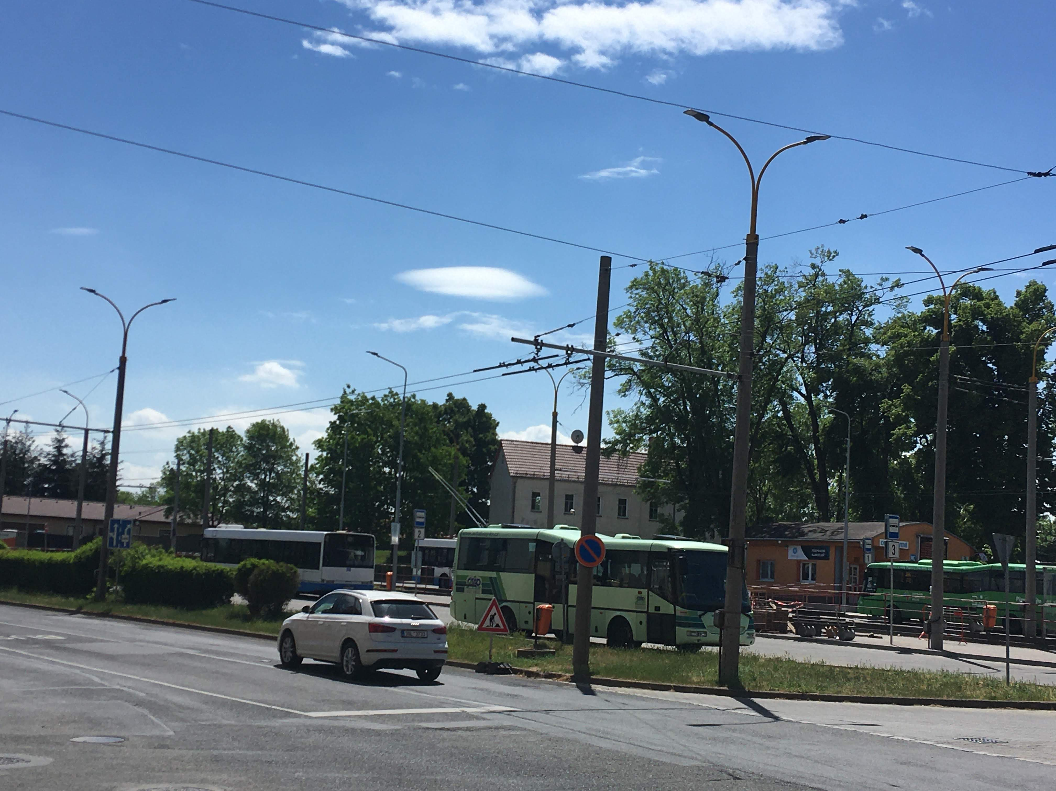
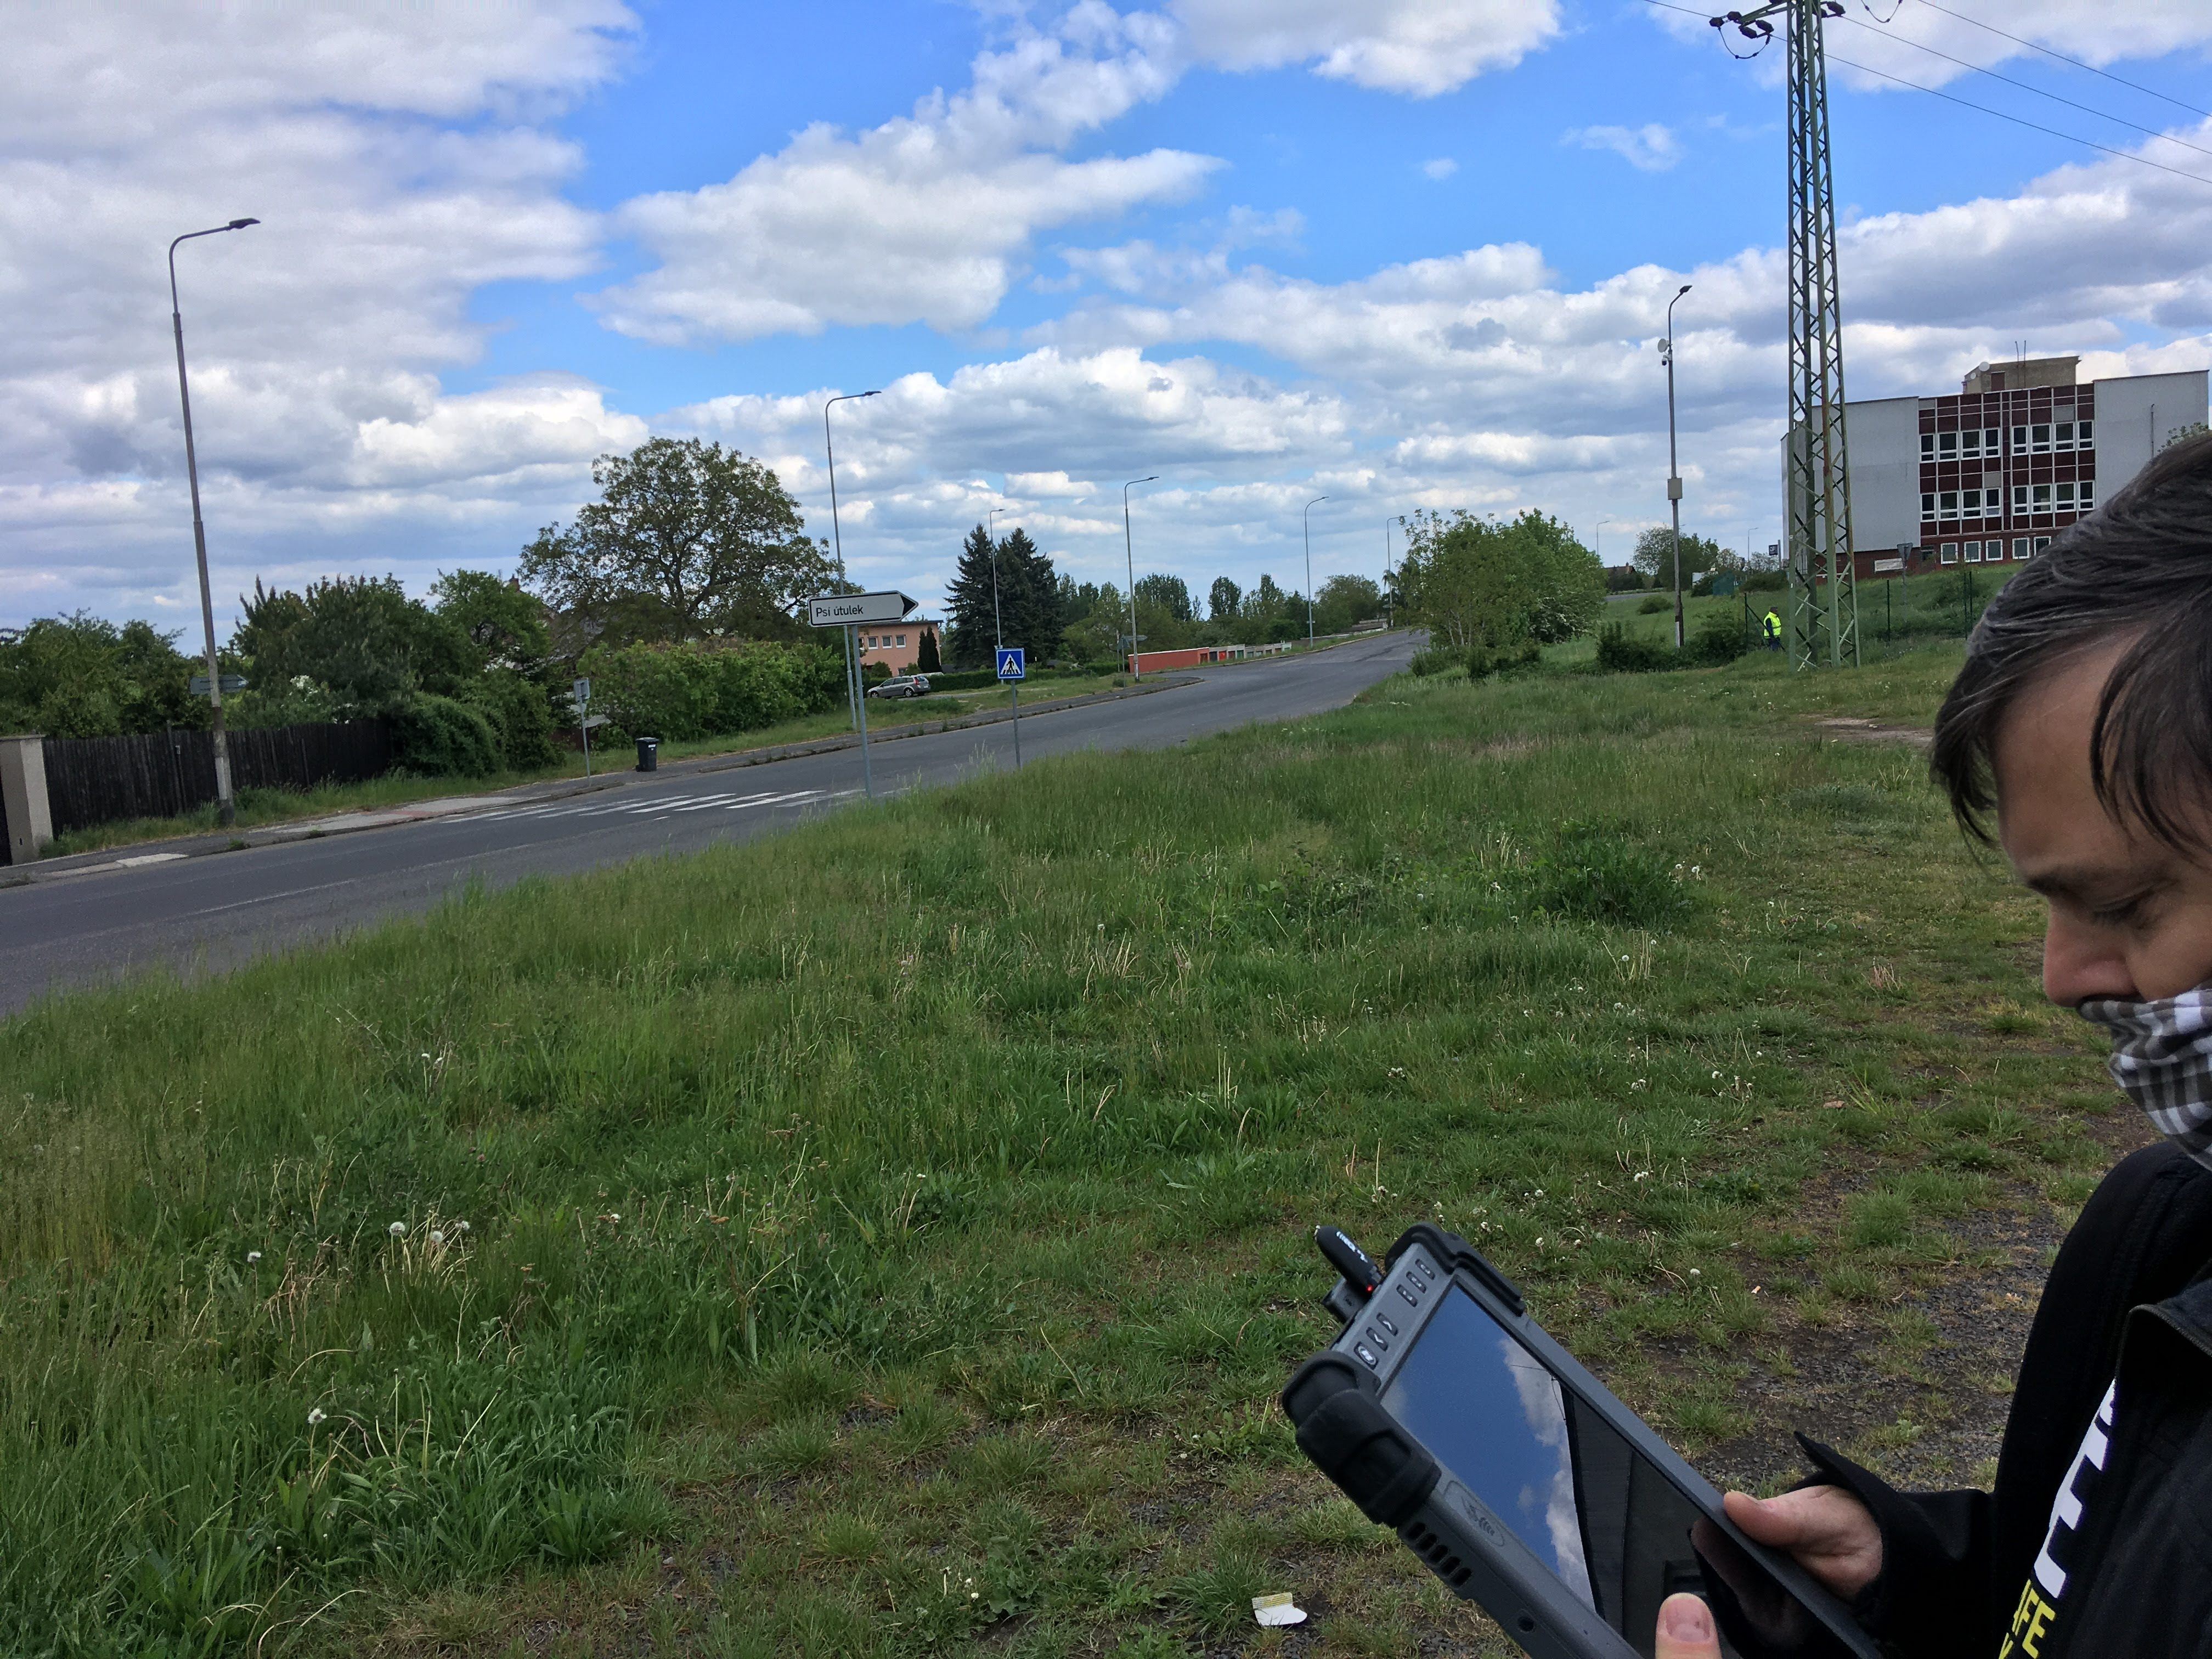
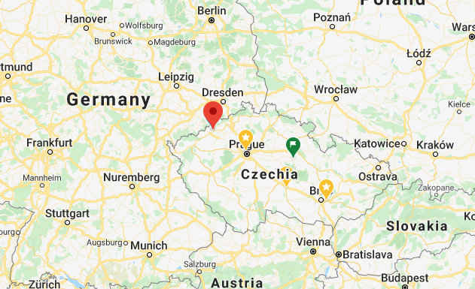
Jirkov city launch
michal.valny@logimic.com www.logimiclight.com
- 220 open-air lamps
- 19 streets
- 3 gateways
- Deployment in streets
- Autonetwork in real traffic
- DP2P Localisation

Slide 12
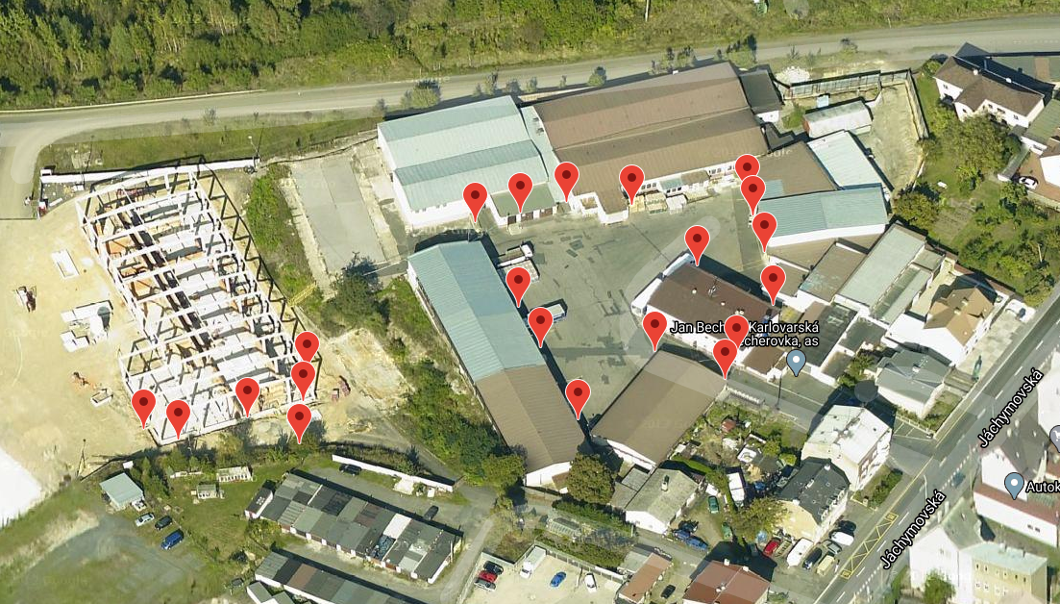
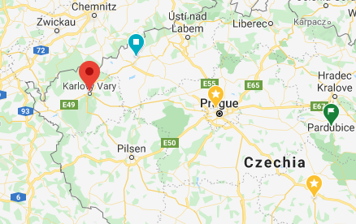
Becher company launch
michal.valny@logimic.com www.logimiclight.com
- 25 open-air lamps
- 4 areas
- 1 gateway
- Remote Deployment
- Remote Autonetwork
- Flash & Go localisation

Slide 13
Logimic Light - benefits
michal.valny@logimic.com www.logimiclight.com
End customer:
Quick overview
Remote control
Light profiles
Notifications
Statistics
Hotline
Manufacturer, Supplier:
Customer data
Performance of devices, alerting
Maintenance notifications
Data analytics
Info channel to customer

Slide 14
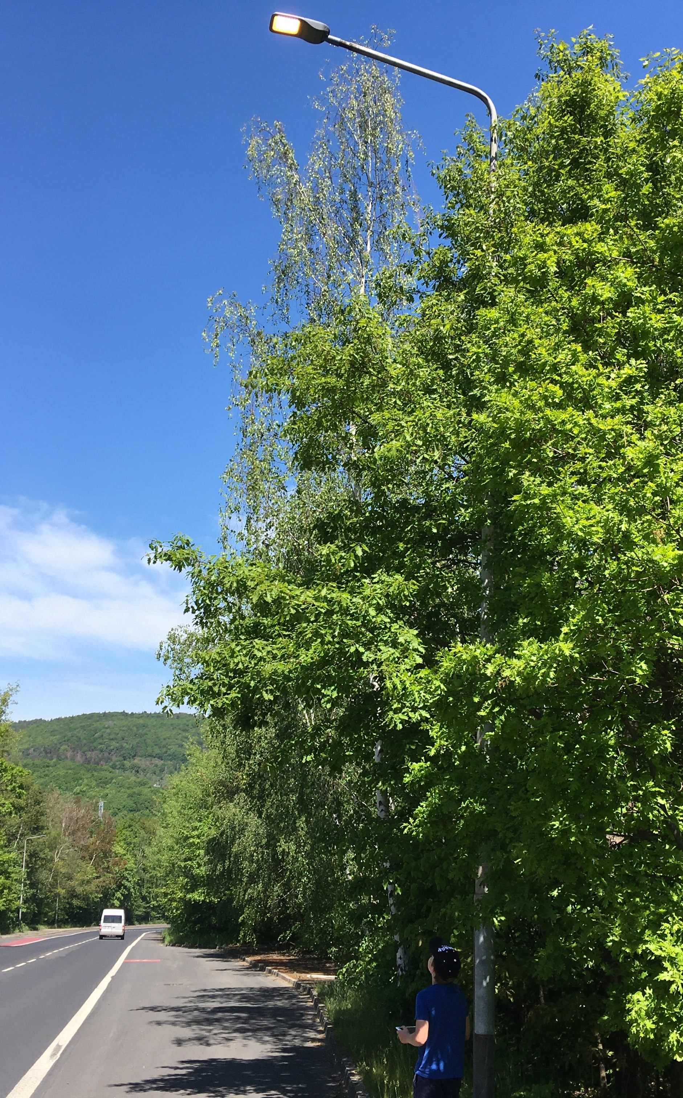
michal.valny@logimic.com www.logimiclight.com
Thank You for your attention!
Michal Valný

